Slide 1
“We Try to Find Something for Whatever Obstacle Might be in Our Way”: Understanding the Health Information Practices of South Carolina LGBTQ+ Communities
Vanessa L. Kitzie
@vkitzie
Travis L. Wagner
@trlwagner
A. Nick Vera
@nickvera22
Valerie Lookingbill
@valerielooking1
Notes:
Val
Research funded by a three-year IMLS early career research grant

Slide 2
Introduction: Re-thinking deficit models
Deficit models focus on identifying problems & needs
Public health policy development addressing failures of individuals & communities to avoid disease (Morgan & Ziglio, 2006; Ziglio et al., 2000)
Library & Information Science (LIS) framing of “needy” individuals (Frohmann, 1992; Julien, 1999; Olsson, 2005
Health librarianship focuses on universal medical information & education (Morris & Hawkins, 2016; Ma, et al., 2018)
Notes:
Val
Research aims to challenge deficit models
Fields of public health, library and information science, and health librarianship
Public health
Historically used deficit models to examine problem and needs – leads to focus on individual and community failures at expense of what they're doing well
Widespread acceptance of socio-ecological model of health – holistic approaches not reflected in institutional structures, organizational decision-making and policy actions
Political, social, culutral, environmental, behaivoral factors interwoven and play role in determining/sustaining health of population
LIS
Positions information need as central concept
Frames people's ignorance – rather than knowledge, as defining characteristic
Approaches conceive people as patients whose symptoms require diagnosis – inequity of power relations
Further seen in health librarianship – focus on universal medical information and education, means groups who don't follow or "fit" within "universal" are excluded

Slide 3
Today’s presentation
Challenges deficit model
Reports empirical findings from research examining health information practices of SC LGBTQ+ communities
Leverages findings into implications for re-framing health librarianship
Notes:
Val
Today’s presentation
Challenges deficit model by …
reporting empirical findings from our research examining health information practices of SC LGBTQ+ communities
Findings have implications for re-framing health librarianship by re-thinking services to LGBTQ+ populations

Slide 4
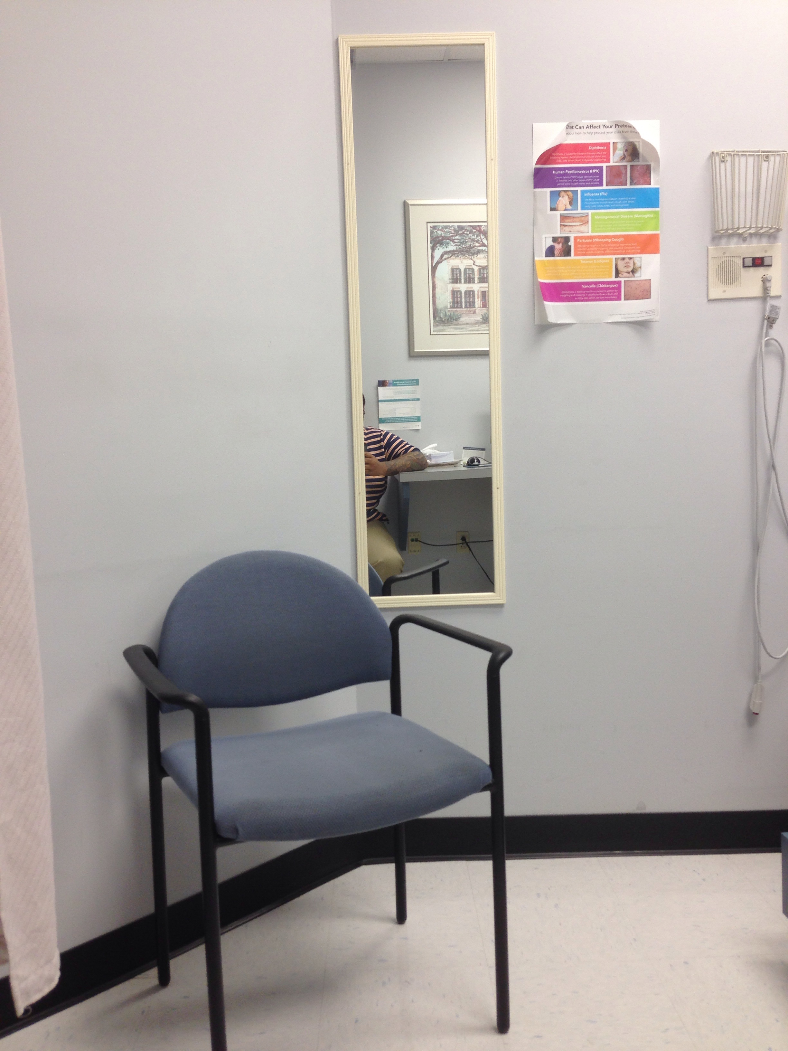
Context: Describing the research study
Interviews with 30 South Carolina LGBTQ+ community leaders
LGBTQ+ populations face significant health challenges (HealthyPeople, 2019)
Challenges exacerbated in South (Matthews & Lee, 2014; Williams Institute, 2018)
Informational barriers (Morris & Hawkins, 2016; Romanelli & Hudson, 2017)
Notes:
Travis
Informed by individuals interviews with 30 SC LGBTQ+ community leaders about their community’s health questions and concerns, and what they do or don’t do to address them
Leader’s provide a bird’s eye view of communities
Leaders were various ages (13+), races/ethnicities, locations, gender identities, sexualities
Why LGBTQ+?
Experience health challenges compared to heterosexual and cisgender peers
Health challenges enhanced in South, where LGBTQ+ people experience greater discrimination, more isolation
In SC LGBTQ+ people have:
Heightened economic instability
Unemployment
Lack of health insurance
…. As compared to national averages
Also experience enhanced discrimination due to LGBTQ+ identity
An relatively unaddressed factor contributing to LGBTQ+ health challenges are informational barriers, such as:
Difficulty learning about healthcare needs
Navigating healthcare system
Addressing barriers to care

Slide 5
Vada, a White lesbian who leads a community of LGBTQ+ adults describes challenges to her community staying healthy:
There aren't many doctors who are willing to listen.[…] There aren't very many therapists that we know of who are good therapists, A, and B, willing and capable of treating complex LGBT issues. Because they are complex. They're different from another standard. Standard. Straight people are standard. It's different than treating somebody who is straight because the issues are simply-- they might be the same in diagnosis, but they're different in causation. So depression from somebody who's LGBT might be because their family has rejected them. Whereas someone who's straight might have depression because their dog died. That's very different. And trying to treat it is going to be very different […] trans women […] have to find alternative ways to get their hormones because there's very few-- trans women have a harder time passing, usually, then trans men. And they're desperate to be on hormones because it changes things. And when doctors aren't willing to prescribe it because they don't understand, it can make it very challenging for them.
Notes:
Travis
Going to illustrate our findings by reading a participant narrative
Vada (white lesbian), who leads a group of LGBTQ+ adults, describing challenges to her community staying healthy.

Slide 6
Pulling it all together: Conceptual model
Risks
Self protective
Community protective
Contextual Conditions:
Gender identity
Sexual orientation
Self defensive:
Seeking
Barriers:
Hetero / cis-normativity
Homo / trans-phobia
Community defensive
Notes:
Travis
Used participant narratives like Vada’s to create a conceptual model that describes what’s going on
Contextual conditions are underlying circumstances shaping how individuals and communities interact with health information
In Vada’s example gender identity and sexual orientation are important conditions
Contextual conditions produce barriers
Barriers are obstacles that constrain individuals and communities from achieving certain informational outcomes
Hetero and cisnormativity are barriers
Represent the idea that being straight and being cisgender are “standard” – anything that deviates from this standard assumption is invisible and abnormal
Homophobia and transphobia are also key barriers
Represent the active negative attitudes toward those who are not straight/cisgender
Both sets of barriers can
Get people kicked out of their homes
Can lead to negative consequences for those who cannot “pass” as a certain gender identity
Contribute to medical professionals’ unwillingness to listen
Barriers, in turn, shape how individuals and communities create, seeking, share, and use health information
In Vada’s example, trans women may find alternate ways to get hormones in response to barriers experienced
Shows how what we might take to be a “risky” practice on the surface (i.e., finding alternate ways to get hormones) is actually well-informed based on communities’ well-reasoned responses to contextual conditions and the barriers they produce
Our model is more expansive than this example (click through) – happy to talk more during discussion or conference

Slide 7
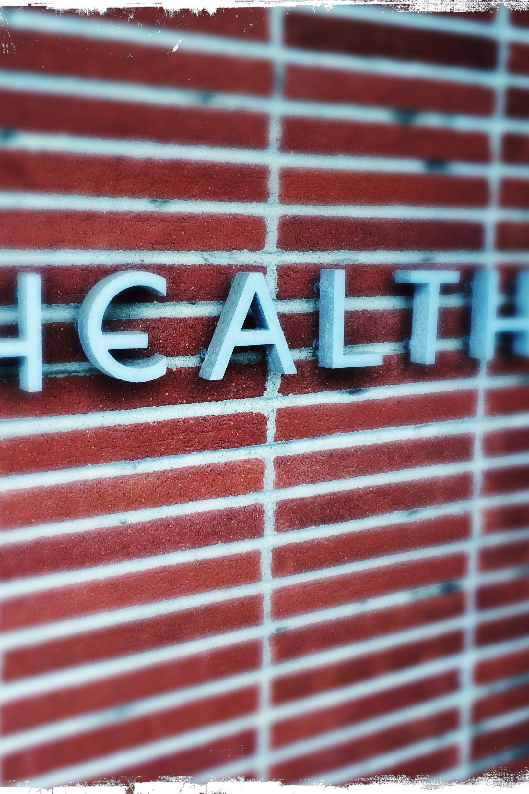
Implications: What can we do with what we’ve found?
Re-orienting professional practice rather than “fixing”
Shift from outreach to engagement (Baba & Abrizah, 2018)
Partnering with community health workers (Raj et al., 2015)
Cultural competency trainings to medical professionals (Cooke, 2017)
Harm reduction workshops (Pollack, 2008)
Notes:
Val
Implications are interrelated
If we accept communities as being knowledgeable about navigating the larger social and structural factors shaping their health information practices, then we need to rethink critical assumptions of our practice
Shift from outreach to engagement
Outreach: provision of resources to community members
Engagement: applies expertise of public concern and partnerships with community members in a way that's beneficial
Discussion with participants about what libraries can do for them – suggestion to have libraries maintain a list of LGBTQ+ friendly doctors
Outreach – providing a list
Engagement – looknig into issues that librarians are experts in, such as persistence (keeping up with doctors moving) and information value (trust), to create/maintain a list over time; requries partnerships with communities
Partner with community health workers
CHWs – highly trusted members of communities; act as critical information intermediaries between community/information professionals
Studies of CHWs show they experience significant informational challenges when performing their jobs; opportunity for health librarians to develop partnerships with them
Cultural competency traiings for medical professionals
Developed/guided by LGBTQ+ communities
Given at libraries
Librarians as facilitators and not as experts
Harm reduction workshops
Everyone engages in risky behaviors, whether driving a car or engaging in sexual activity
Harm reduction strategies – wearing a seatbelt or using a condom
Other types of harm reduction strategies which are often stigmatized – how to address challenges encountered when self-prescribing hormones, engaging in sex work, or using drugs
Needs to be an understanding that these activities are informed and often necessary due to social and structural factors for LGBTQ+ people and marginalized groups
Need to normalize harm reduction with focus on specific challenges experienced by LGBTQ+ communities

Slide 8
Thank you!
Questions?
For more project info:
http://bit.ly/hiplgbtq
Notes:
Val

Slide 9
References (1)
Baba, Z., & Abrizah, A. (2018). Transformation strategies in community engagement: Selected initiatives by Malaysian libraries. IFLA journal, 44(2), 90-105.
Cooke, N. A. (2016). Information services to diverse populations: Developing culturally competent library professionals. ABC-CLIO.
Frohmann, B. (1992) The Power of Images: A Discourse Analysis of the Cognitive Viewpoint. Journal of Documentation, 48, 365-386.
Julien, H. (1999). Where to from here? Results of an empirical study and user-centred implications for information design. In T. D. Wilson and D. K. Allen (Eds) Exploring the Contexts of Information Behaviour, (pp. 586-596) London, Taylor Graham.

Slide 10
References (2)
Ma, J., Stahl, L., & Knotts, E. (2018). Emerging roles of health information professionals for library and information science curriculum development: a scoping review. Journal of the Medical Library Association: JMLA, 106(4), 432.
Matthews, D. D., & Lee, J. G. (2014). A profile of North Carolina lesbian, gay, and bisexual health disparities, 2011. American journal of public health, 104(6), e98-e105.
Morgan, A. & Ziglio, E. (2006) Foreword. In: Capability and resilience: beating the odds. Department of Epidemiology and Public Health, University College London, London.
Morris, M., & Hawkins, B. (2016). Towards a new specialization in health librarianship: LGBTQ health. Journal of the Canadian Health Libraries Association, 37(1), 20-23.

Slide 11
References (3)
Olsson, M. (2005). Beyond ‘needy’individuals: conceptualizing information behavior. Proceedings of the American Society for Information Science and Technology, 42(1).
Pollack, H. (2008). Moral, prudential, and political arguments about harm reduction. Contemporary Drug Problems, 35, 211 - 239.
Raj, S., Sharma, V. L., Singh, A., & Goel, S. (2015). The health information seeking behaviour and needs of community health workers in C handigarh in N orthern I ndia. Health Information & Libraries Journal, 32(2), 143-149.
Romanelli, M., & Hudson, K. D. (2017). Individual and systemic barriers to health care: Perspectives of lesbian, gay, bisexual, and transgender adults. American Journal of Orthopsychiatry, 87(6), 714.

Slide 12
References (4)
Williams Institute (2018). LGBT people in South Carolina. Retrieved from: https://williamsinstitute.law.ucla.edu/wp-content/uploads/South-Carolina-fact-sheet.pdf
Ziglio, E., Hagard. S. & Griffiths, J. (2000) Health promotion development in Europe: acheivments and challenges. Health Promotion International vol 15, no. 2, pp. 143-153.

