Slide 1
Resituating library values to leverage the health information practices of south Carolina lgbtq+ communities
Vanessa L. Kitzie
@vkitzie
Travis L. Wagner
@trlwagner
A. Nick Vera
@nickvera22
Valerie Lookingbill
@valerielooking1
Notes:
Travis
Research funded by a three-year IMLS early career research grant

Slide 2
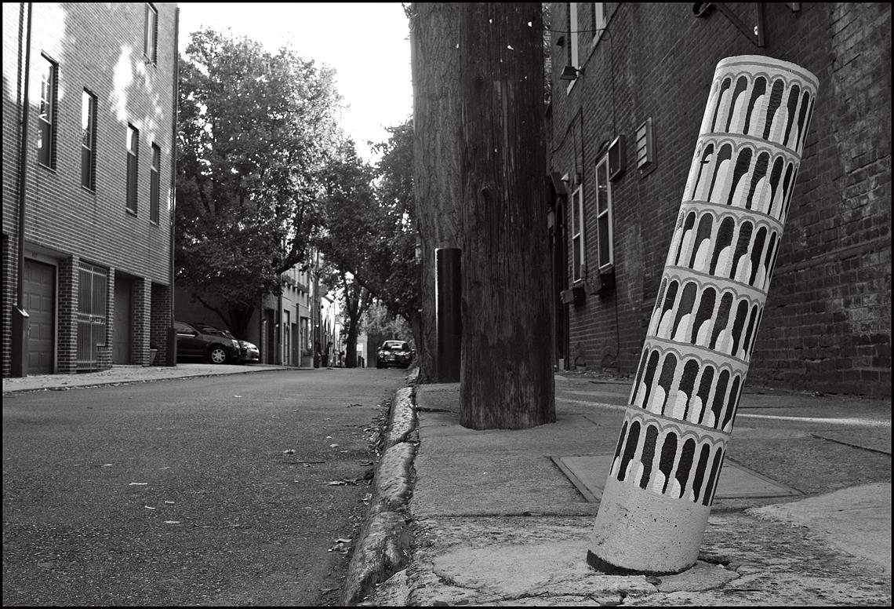
Introduction: Re-thinking deficit models
Deficit models focus on identifying problems & needs
Public health policy development addressing failures of individuals & communities to avoid disease (Morgan & Ziglio, 2006; Ziglio et al., 2000)
Library & Information Science (LIS) framing of “needy” individuals (Frohmann, 1992; Julien, 1999; Olsson, 2005
Health librarianship focuses on universal medical information & education (Morris & Hawkins, 2016; Ma, et al., 2018)
Notes:
Travis
Research aims to challenge deficit models
Fields of public health, library and information science, and health librarianship
Public health
Historically used deficit models to examine problem and needs – leads to focus on individual and community failures at expense of what they're doing well
Widespread acceptance of socio-ecological model of health – holistic approaches not reflected in institutional structures, organizational decision-making and policy actions
Political, social, culutral, environmental, behaivoral factors interwoven and play role in determining/sustaining health of population
LIS
Positions information need as central concept
Frames people's ignorance – rather than knowledge, as defining characteristic
Approaches conceive people as patients whose symptoms require diagnosis – inequity of power relations
Further seen in health librarianship – focus on universal medical information and education, means groups who don't follow or "fit" within "universal" are excluded

Slide 3
Today’s presentation
Challenges deficit model
Reports empirical findings from research examining health information practices of SC LGBTQ+ communities
Leverages findings into implications for re-framing librarianship
Notes:
Travis
Today’s presentation
Challenges deficit model by …
reporting empirical findings from our research examining health information practices of SC LGBTQ+ communities
Findings have implications for re-framing public and health librarianship by re-thinking services to LGBTQ+ populations

Slide 4
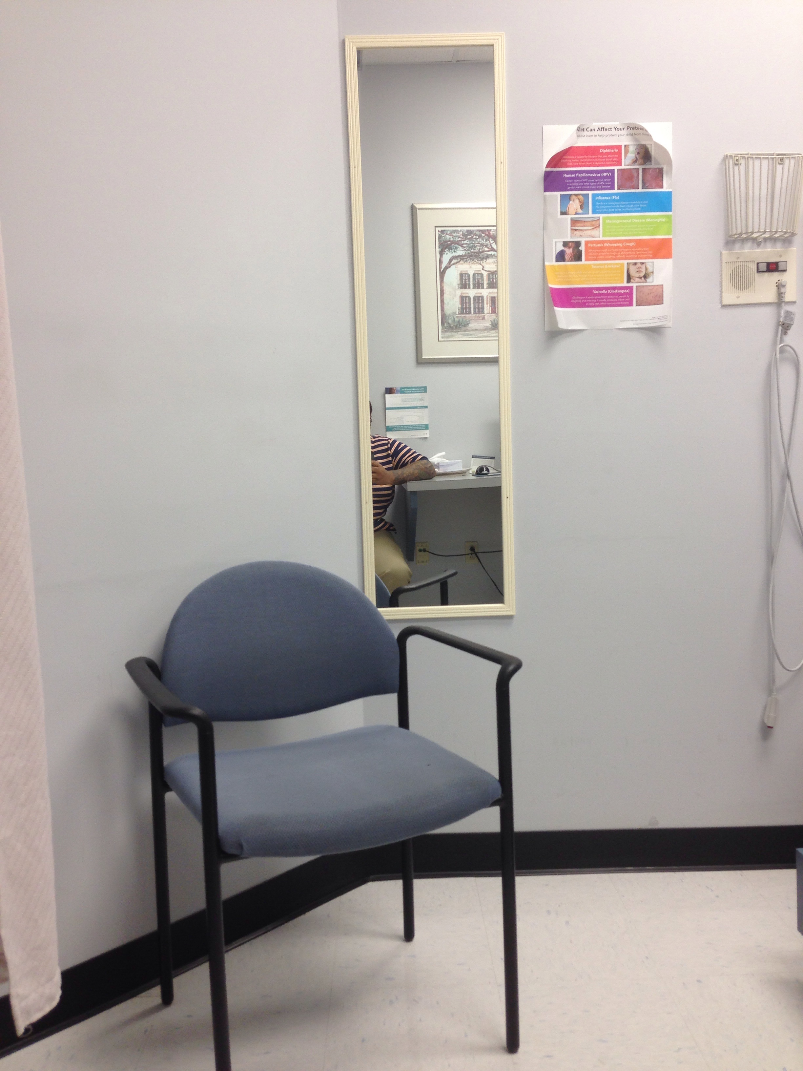
Context: Describing the research study
LGBTQ+ populations face significant health challenges (HealthyPeople, 2019)
Challenges exacerbated in South (Matthews & Lee, 2014; Williams Institute, 2018)
Informational barriers (Morris & Hawkins, 2016; Romanelli & Hudson, 2017)
Notes:
Travis
LGBTQ+ people experience health challenges compared to heterosexual and cisgender peers
Health challenges enhanced in South, where LGBTQ+ people experience greater discrimination, more isolation
In SC LGBTQ+ people have:
Heightened economic instability
Unemployment
Lack of health insurance
…. As compared to national averages
Also experience enhanced discrimination due to LGBTQ+ identity
An relatively unaddressed factor contributing to LGBTQ+ health challenges are informational barriers, such as:
Difficulty learning about healthcare needs
Navigating healthcare system
Addressing barriers to care

Slide 5
Research questions
RQ1: How does sociocultural context shape the health information practices of SC LGBTQ+ communities?
RQ2: What are the implications of research findings for librarianship?
Notes:
Travis
Gaps in the literature led informed our research questions (read questions)

Slide 6
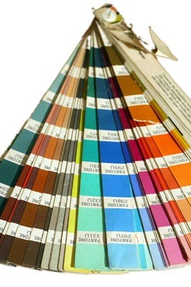
Methods
30 SC LGBTQ+ community leaders ages 13+
IRB waiver of parent/guardian consent
Sampling: Purposive, Snowball, Theoretical
Semi-structured interviews
Information worlds mapping (Greyson, 2013)
In-person interviews (with exception of 2 telephone)
Interviews audio-recorded & transcribed
Open qualitative coding (Strauss & Corbin, 1994)
Validity: Team coding meetings, member-checking, multiple data collection methods
Pseudonyms used
Notes:
Travis
Happy to provide more in-depth methods info during discussion
Interviewed 30 SC LGBTQ+ community leaders
Leaders provide a bird’s eye view of their communities
Emailed a list of 100+ LGBTQ+ and affinity organizations in SC asking them to nominate a community leader to participate
Asked leaders to recommend other participants
Used theoretical sampling to inform social media recruitment
Important to note that leaders can be youth; IRB waiver for parent/guardian consent
Semi-structured interviews averaged 78 minutes and covered:
Community involvement identities, health questions/concerns, and practices for addressing questions/concerns
Following interviews, participants engaged info worlds mapping, a visual elicitation method, to provide a diff. way to address interview themes
Data consisted of interview transcripts, field notes, and info world maps
Focus on info worlds map and transcript analysis for this presentation
Met as a group to hand-code three transcripts and build a preliminary codebook
Refined codebook using four additional transcripts
Constantly compared emergent and existing codes, resolving discrepancies among coders
Then coded remaining transcripts independently
Engaged in member-checking where participants accessed their transcripts to comment on how well they reflected lived experiences, as well as highlight any identifying info

Slide 7
Participant Demographics
Table 1. Age Range
Age | n | %
18-25 | 11 | 37%
35-54 | 7 | 24%
55-64 | 4 | 14%
13-17 | 4 | 14%
26-34 | 3 | 10%
65+ | 1 | 4%
Table 2. Race & Ethnicity
Race & Ethnicity | n | %
White | 18 | 60%
Black | 7 | 24%
Black, White | 2 | 7%
Black, Afro-Caribbean | 1 | 4%
Aboriginal, Arab/West Asian, Black, White | 1 | 4%
Black, White, Egyptian | 1 | 4%
Table 3. Education
Education | n | %
Some college credit | 7 | 24%
Master’s degree | 6 | 20%
Associate degree | 5 | 17%
Bachelor’s degree | 5 | 17%
In high school | 2 | 7%
In middle school | 2 | 7%
High school diploma | 1 | 4%
Doctoral degree | 1 | 4%
GED or alt. credential | 1 | 4%
Notes:
Travis
Majority of participants were young adults (18-25) and middle-aged
Race/ethnicity reflects that of LGBTQ+ people at broader state-level
Under-representation of Latinx communities, which have presence in SC
Education varied, but common for participants to have some degree of higher education

Slide 8
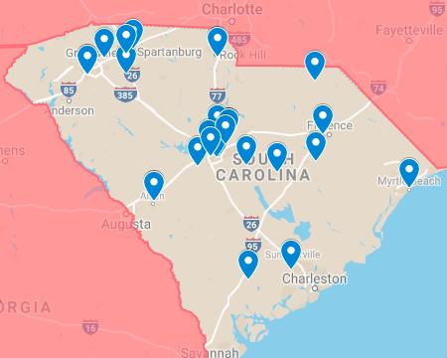
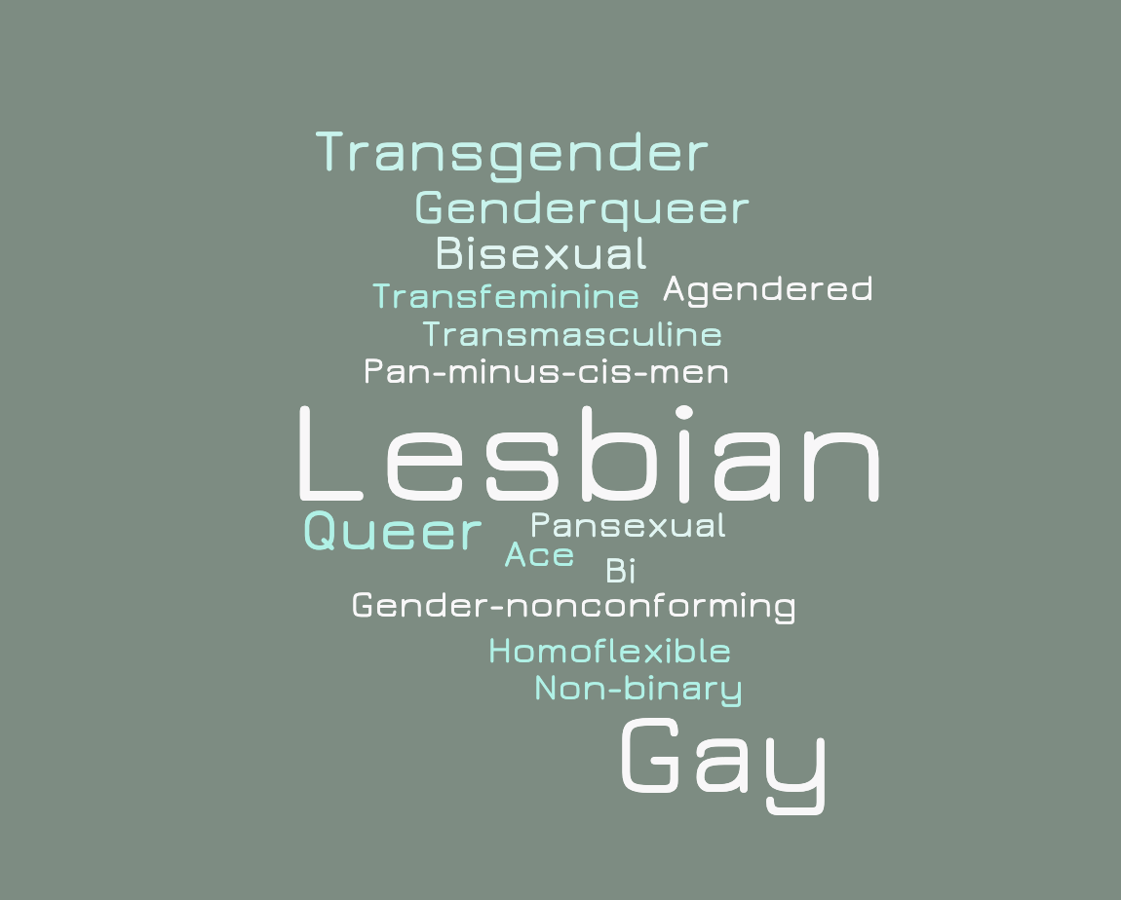
Participant Demographics
Notes:
Travis
Geographic distribution spread across the state, with concentrations in Upstate and Midlands regions
Fewer participants in Coastal Lowcountry and Pee Dee regions reflect smaller populations and less visible organizations
Charleston has an active, visible LGBTQ+ population, but did not participate in interviews
While most participants identified as lesbian and gay, they used other labels to describe sexualities and gender identities
Denotes inability of umbrella labels like LGBTQ+ to capture multiplicity and fluidity of participant identities

Slide 9
Conceptual model
Risks
Self protective
Community protective
Contextual Conditions
Self defensive
Barriers
Community defensive
Notes:
Vanessa
Through second-cycle coding, we developed a conceptual model describing how sociocultural context shapes the health information practices of LGBTQ+ populations
The first part of the model is contextual conditions
These are underlying circumstances shaping how individuals and communities interact with health information, such as identity, economics, and politics
Contextual conditions produce risks and barriers faced by individuals and communities
Risks are perceived exposure to danger, harm, or loss that might result from engaging in specific information practices
Examples of risks identified during data analysis: physical violence, being kicked out, and fear of the unknown
Barriers are obstacles that constrain individuals and communities from achieving certain informational outcomes
Examples of barriers identified during data analysis: family, law, religion
Risks and barriers are co-constitutive (e.g., what is a barrier for one can be a risk for another when they hear about it)
Risks produce protective information practices
They are instances where individuals or communities create, seek, share, and use information to guard against a perceived risk or risks
These practices are proactive
Barriers produce defensive information practices
They are instances where individuals or communities create, seek, share, and use information to defend against a barrier or barriers
These practices are reactive
Now will illustrate this model with three participant narratives
In these narratives, participants describe their information worlds map. Will show the map in full, but focus on specific areas.

Slide 10
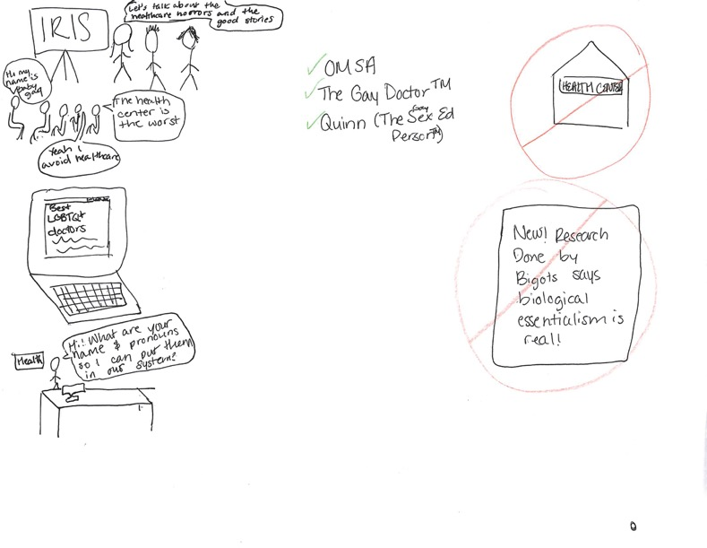
Kyle “transmasculine, genderqueer, non-binary, also ace, maybe lesbian” leader within LGBTQ campus organization
Notes:
Vanessa
First narrative is from Kyle, a self-described transmasculine, genderqueer, non-binary, ace, and ”maybe lesbian” leader within an LGBTQ campus organization. Here’s how he describes this community’s information world:
This is kind of the community and how we talk about health care. We're like, "Okay, let's talk about the health care horrors and the good stories." And this person is saying, "The health center's the worst."
And this person's saying, "Yeah, I avoid health care," which is why the health center is crossed out in red because we tend to avoid it because it's not good.
And then there's a laptop with the internet up. It's like, "The best LGBTQ doctors." because everything is the internet. It's like, "Hey, I went to this doctor, and they actually knew about gay people," or like, "Hey, they actually knew about trans people, so maybe we should go to this doctor." Then everybody flocks there.
This is a person at a health desk at a doctor's office or something. They're saying like, "Hi, what are your name and pronouns so I can put them in our system?" I should have drawn somebody actually using those name and pronouns later because that's usually not what happens. That's the missing link in the system right now.
Over here is, "New. Research done by bigots says that biological essentialism is real." So that's got a big old X around it. We're like, "We don't want that research. Get out of here."

Slide 11
Model applied to Kyle’s narrative
Risks
Self protective
Community protective
Contextual Conditions:
Age
Class
Education
Gender identity
Sexuality
Self defensive
Community defensive:
Avoiding
Use
Sharing (Word of mouth)
Barriers:
Medical
Research
Notes:
Vanessa
Model can help us interpret this narrative
Contextual conditions
Age, class, education, gender identity, and sexuality are core shared identities of community members
Gives participants access to health institutions, such as a health center, which others might not have access to
Barriers
Participant questions authority of “expert” institutions (e.g., medicine, research) with regard to LGBTQ+ health
Invalidating experiences with medical professionals and research literature
Community defensive practices
Avoiding
Active response to a negative outcome that has already occurred and that the community is collectively aware of. In Kyle’s account, they are avoiding the health center due to ”horror stories” shared by other community members.
Word of mouth
Specific type of sharing is called “word of mouth” – the act of passing experiential, trustworthy information from person to person within a community to defend against negative outcomes already experienced by other community members
Use
Community makes decisions of which healthcare providers to visit and which to avoid, as well as what research studies to read, based on word of mouth
Key points
Communities question authority of “expert” institutions (e.g., medicine, research) with regard to LGBTQ+ health
This skepticism is shaped by prior negative experiences that the community collectively works to defend against using information practices like word of mouth

Slide 12
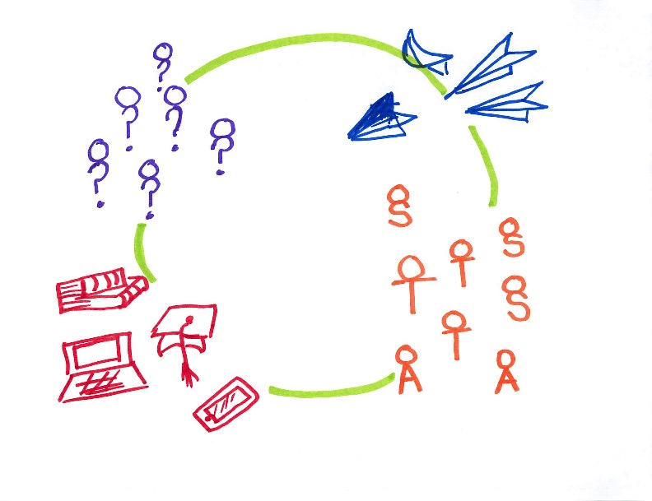
Deb “lesbian minister from a very poor background” who leads a faith congregation
Notes:
Vanessa
Second narrative is from Deb, a self-described lesbian minister from a very poor background who leads a faith congregation. Here’s how Deb describes her community’s information world:
These are people [in the community] that answer questions. These are the sort of people in the know.
And what they do is they have book knowledge, or they're professionals. But it has to be very straightforward questions.
Otherwise, we [have] to refer people ... all the sick people, the transgender people [to get] people to places. This is not about getting the information. This is about getting the referral. [We only provide information] that's not going to be life-threatening or you absolutely sure about.
This is the information coming in. It's like paper airplanes. This one's [bouncing off] stuff because it's fake news. [The other airplanes] are things we're letting in ... [The health information we let in] has to have scientific study. We['ve] got to have a number of scientific studies that support this thing and not just some made-up stuff. At least some good hardcore evidence that it's not hurting anybody.

Slide 13
Model applied to Deb’s narrative
Risks:
Threatening one’s health & wellbeing
Self protective
Community protective:
Sharing (Mediating)
Use
Contextual Conditions:
Class
Education
Gender identity
Sexuality
Self defensive
Barriers
Community defensive
Notes:
Vanessa
Again, going to run Deb’s narrative through the model
Contextual conditions
Class, education, gender identity, and sexuality are core identities of community members
Significant emphasis made by Deb on education
Alludes to transgender people not having as much access to healthcare
Risks
Threatening one’s health and wellbeing by making unsafe decisions, acting on false information
Community protective sharing
Community engages in information sharing to guard against this risk
Particular type of sharing called mediating
Connecting community members with information and resources to meet their needs that also guards against perceived negative consequences
Community protective use
Community guards against the risk of anyone in the community getting hurt by assessing information before using it to make decisions
Key point:
Even within a community where members engage with more formal sources (e.g., research studies), they still insulate these engagements within the community via mediating and community protective use

Slide 14
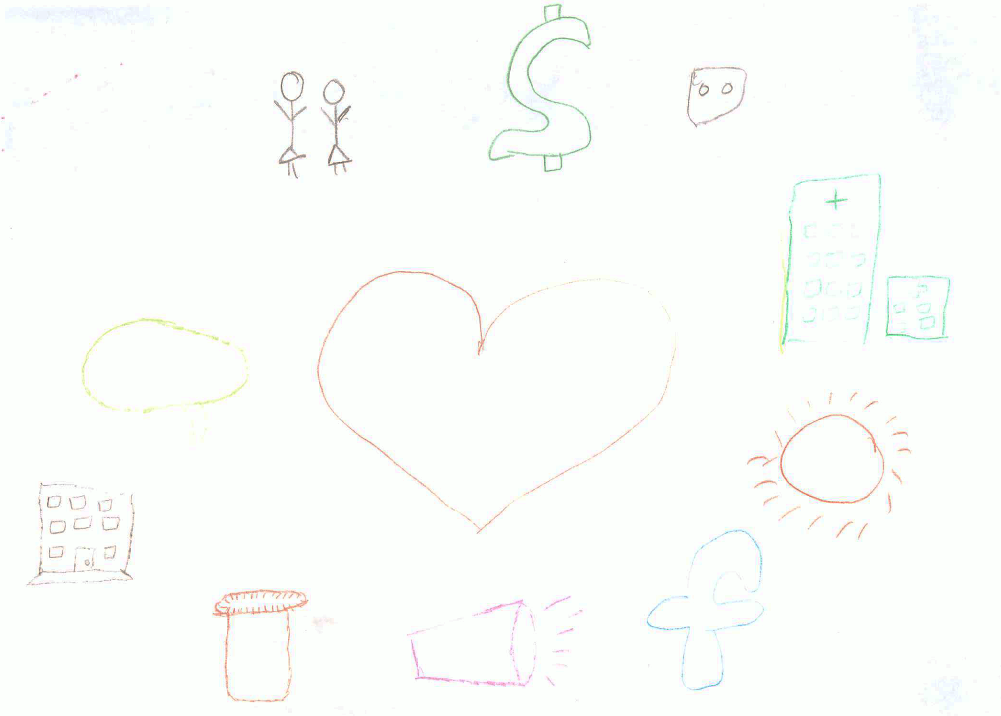
Pat “Black, Afro-Carribbean transfeminine, gender-nonconforming person” who leads a grassroots organization for Black, queer, and trans people
Notes:
Vanessa
Final narrative is from Pat, a self-described Black, Afro-Carribbean transfeminine, gender-nonconforming person” who leads a grassroots organization for Black, queer, and trans people. Here’s how she describes this community’s information world:
I include unlicensed vendors, who you can consult with about prescribing yourself medicines and treatments and other substances that you might find either beneficial to you or help you to cope with different personal needs. So that's symbolized by this orange thing that's supposed to be like-- a pill container.
I made a version of a logo of a dating app called Grindr. Grindr and other dating and hookup apps, they usually have these sections where you input information about your health. I think that on a day-to-day basis that's where people are interacting with health information the most besides personal health information.
I have a a dollar sign. It’s really important for me to highlight the ways that queer and trans people in my community are exploited by different health-based organizations and companies. Our health information and data is profitable, point blank, period. … A really subtle way that I don't think people realize that they're providing health information is those DNA tests that … that have gained in popularity, especially among African-Americans who don't really have access to genealogical information.

Slide 15
Model applied to pat’s narrative
Risks:
Threatening one’s health & wellbeing
Self protective
Community protective:
Exchanging (Identity disclosure)
Contextual Conditions:
Class
Race
Gender identity
Sexuality
Self defensive:
Seeking
Barriers:
Lack of access
Racism
Community defensive
Notes:
Vanessa
Contextual conditions
Class, race, gender identity, and sexuality are core shared identities of community members
Barriers
Lack of access to formal medical system and resources
Racism, particularly evidenced in history of medicalized exploitation of people of color, predominately Black people
Risks
Similar to Deb’s account, there’s a concern among community members of risks to their health and wellbeing
Community protective exchanging
Specific risk alluded to in Pat’s account was in relation to Grindr, a dating app
Collective practice on that app for people to collectively exchange (aka with expectation that you’ll receive information in return) their health information to guard against risks to their wellbeing, such as getting an STI
Self defensive seeking
Individuals look for information about self-prescribing in response to lack of access to formal medical system and resources
Key points:
Difference between self and community level information practices
Intersecting contextual conditions produce qualitatively distinct experiences for different groups
People engage in practices that might appear risky (e.g., consulting with unlicensed vendors), but in context are informed and in response to risks and barriers that are socioculturaly produced

Slide 16
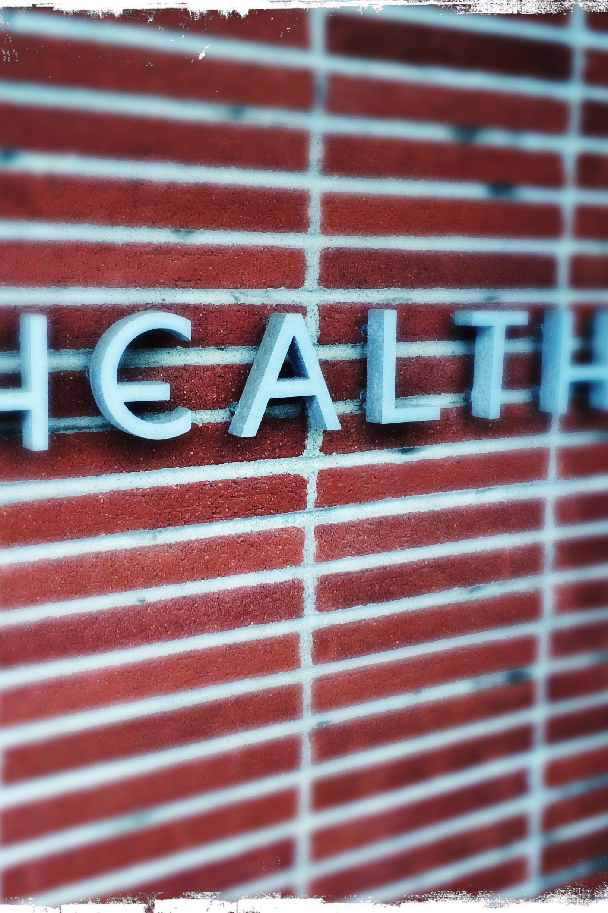
Summary of key findings
Communities question authority of “expert” institutions (e.g., medicine, research) with regard to LGBTQ+ health
Skepticism shaped by prior & anticipated negative outcomes
Intersecting contextual conditions produce qualitatively distinct experiences for individuals & communities
Communities guard against negative outcomes via defensive & protective information practices
People engage in practices that appear risky but are informed in context
Information practices also exercised at individual level

Slide 17
Implications: What can we do with what we’ve found?
LIS education
Need for social responsibility & diversity in LIS education
New teaching methods:
Set of skills to determine how sociocultural context shapes information practices
Shift from passive learning to active learning
Library responses
Re-orienting professional practice rather than “fixing”
Shift from outreach to engagement (Baba & Abrizah, 2018)
Partnering with community health workers (Raj et al., 2015)
Cultural competency trainings to medical professionals (Cooke, 2017)
Harm reduction workshops (Pollack, 2008)
Health librarianship
Practical learning experiences based in the community
Nuanced understandings of their communities before working with them professionally
Notes:
Travis
LIS education
As librarians, we need to deliver high-quality information to all members of society
Findings from this study further indicate that LIS education would benefit from embedding more social responsibility and diversity into curricula.
Conducting outreach in the community would allow students to engage in marginalized information research and understand the social and structural barriers that contribute to information poverty
Emphasizing these concepts of social responsibility and diversity would help develop more socially conscious librarians who focus on the patron-librarian relationship and foster compassionate, socially conscious librarians who act as agents of change
When we teach about services, this is where our research information belongs
Library-based interventions
Implications are interrelated
If we accept communities as being knowledgeable about navigating the larger social and structural factors shaping their health information practices, then we need to rethink critical assumptions of our practice
Shift from outreach to engagement
Outreach: provision of resources to community members
Engagement: applies expertise of public concern and partnerships with community members in a way that's beneficial
Discussion with participants about what libraries can do for them – suggestion to have libraries maintain a list of LGBTQ+ friendly doctors
Outreach – providing a list
Engagement – looknig into issues that librarians are experts in, such as persistence (keeping up with doctors moving) and information value (trust), to create/maintain a list over time; requries partnerships with communities
Partner with community health workers
CHWs – highly trusted members of communities; act as critical information intermediaries between community/information professionals
Studies of CHWs show they experience significant informational challenges when performing their jobs; opportunity for health librarians to develop partnerships with them
Cultural competency traiings for medical professionals
Developed/guided by LGBTQ+ communities
Given at libraries
Librarians as facilitators and not as experts
Harm reduction workshops
Everyone engages in risky behaviors, whether driving a car or engaging in sexual activity
Harm reduction strategies – wearing a seatbelt or using a condom
Other types of harm reduction strategies which are often stigmatized – how to address challenges encountered when self-prescribing hormones, engaging in sex work, or using drugs
Needs to be an understanding that these activities are informed and often necessary due to social and structural factors for LGBTQ+ people and marginalized groups
Need to normalize harm reduction with focus on specific challenges experienced by LGBTQ+ communities
Health Librarianship
Findings from this study have suggested that distributing health resources have a ripple effect and can aid countless community members in unseen and unknown ways
They cannot only locate a variety of information resources but deliver them in a user-oriented way
They have the unique opportunity to inform medical professionals of the sociocultural barriers and risks that impact an individual’s access to information, as well as share the information collectively sought and disseminated by communities
Health librarians require nuanced understandings of the sociopolitical and cultural climates within their communities, thus students pursuing these careers would benefit by being embedded into these communities before working with them in a professional sense.

Slide 18
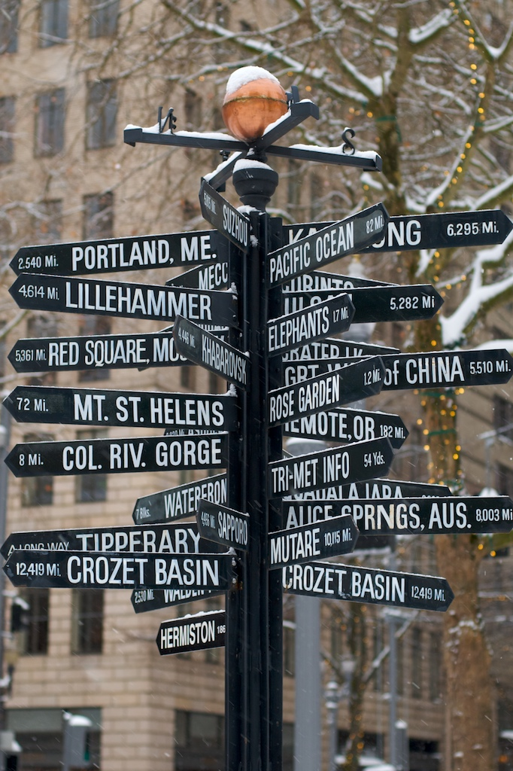
Future Directions
Focus groups with SC LGBTQ+ leaders’ community members
Recruit underrepresented participants in current sample
Interviews with health & medical librarians, medical practitioners
Notes:
Travis
This research has several future directions. Our next step is to conduct focus groups with participants’ communities to validate and expand the current findings from our leader interviews. We’ll also work on employing more nuanced and embedded strategies to recruit participants who are underrepresented in the current sample. In the future, we’ll also conduct interviews with health and medical librarians, in addition to medical professionals, to better understand their information practices in relation to the LGBTQ+ communities they serve.

Slide 19
Thank you!
Questions?
For more project info:
http://bit.ly/hiplgbtq
Notes:
Travis

Slide 20
References
Adler, M. (2017). Cruising the library: Perversities in the organization of knowledge. New York, NY: Fordham University Press
Cooke, N. A. (2018). Creating Mirrors and Doors in the Curriculum: Diversifying and Re-Envisioning the MLS. In Re-envisioning the MLS: Perspectives on the Future of Library and Information Science Education (pp. 27-48). Emerald Publishing Limited.
Greyson, D. (2013). Information world mapping: A participatory, visual, elicitation activity for information practice interviews. Proceedings of the American Society for Information Science and Technology, 50(1), 1-4.
Hillary G. A. (1995). Definitions of community: Areas of agreement. Rural Sociology, 20, 111-123.

Slide 21
References
Hoffman, N. D., Freeman, K., & Swann, S. (2009). Healthcare Preferences of Lesbian, Gay, Bisexual, Transgender and Questioning Youth. Journal of Adolescent Health, 45(3), 222–229.
Irvin, V. (2016). Gazing the diversity stance in North America: Bringing practitioner inquiry into the LIS classroom. Journal of Education for Library and Information Science, 57(2), 151-160.
Jaeger, P. T., Bertot, J. C., & Franklin, R. E. (2010). Diversity, inclusion, and underrepresented populations in LIS research. The Library Quarterly, 80(2), 175-181.
Klein, E. W., & Nakhai, M. (2016). Caring for LGBTQ patients: Methods for improving physician cultural competence. The International Journal of Psychiatry in Medicine, 51(4), 315-324.

Slide 22
References
Lockmiller, C. (2019) Against medicine: Constructing a queer-feminist community health informatics and librarianship. In the Library With The Leadpipe. Retrieved from http://www.inthelibrarywiththeleadpipe.org/2019/against-medicine/
Ma, J., Stahl, L., & Knotts, E. (2018). Emerging roles of health information professionals for library and information science curriculum development: a scoping review. Journal of the Medical Library Association: JMLA, 106(4), 432.
Martin, E. R. (2019). Social justice and the medical librarian. Journal of the Medical Library Association: JMLA, 107(3), 291.

Slide 23
References
Morris, M., & Hawkins, B. (2016). Towards a new specialization in health librarianship: LGBTQ health. Journal of the Canadian Health Libraries Association, 37(1), 20-23. Pohjanen, A. M., & Kortelainen, T. A. M. (2016). Transgender information behaviour. Journal of Documentation, 72(1), 172-190.
Savolainen, R. (2008). Everyday information practices: a social phenomenological perspective. Scarecrow Press.
Steinke, J., Root-Bowman, M., Estabrook, S., Levine, D. S., & Kantor, L. M. (2017). Meeting the needs of sexual and gender minority youth: formative research on potential digital health interventions. Journal of Adolescent Health, 60(5), 541-548.

